Slide 1
ELEGANT model and K-same

Slide 2
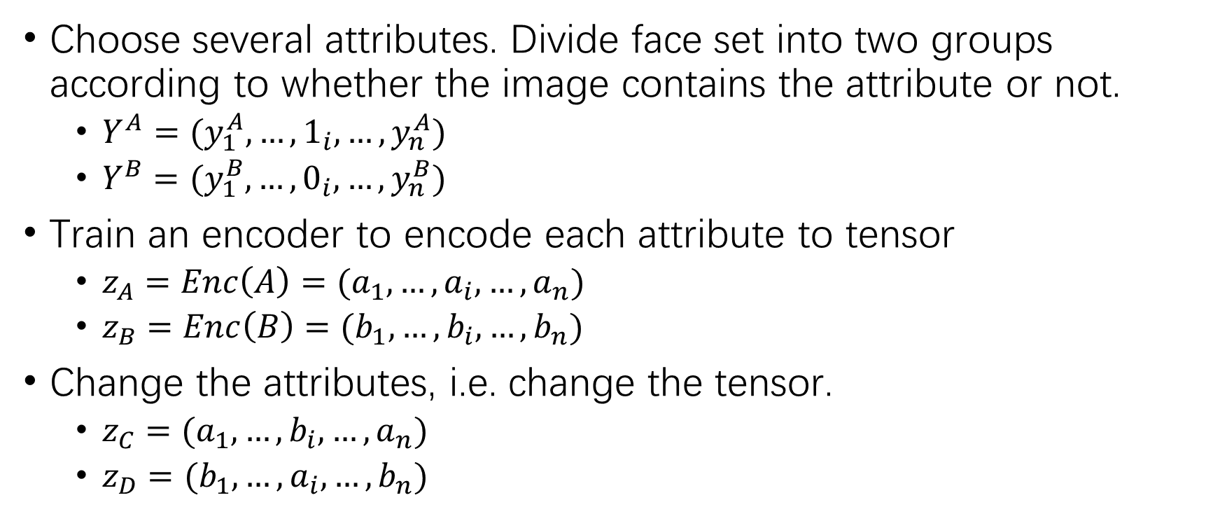
ELEGANT model
Choose several attributes. Divide face set into two groups according to whether the image contains the attribute or not.
$Y^{A}=(y_{1}^{A}, …, 1_{i}, …,y_{n}^{A})$
$Y^{B}=(y_{1}^{B}, …, 0_{i}, …,y_{n}^{B})$
Train an encoder to encode each attribute to tensor
$z_{A}=Enc\left(A\right)=(a_{1}, …,a_{i},…,a_{n})$
$z_{B}=Enc\left(B\right)=(b_{1}, …,b_{i},…,b_{n})$
Change the attributes, i.e. change the tensor.
$z_{C}=(a_{1}, …,b_{i},…,a_{n})$
$z_{D}=(b_{1}, …,a_{i},…,b_{n})$

Slide 3

ELEGANT model
Train a decoder to decode each tensor to residual image
${Dec(z_{C},z}_{A})=R_{C}, A^{′}=A+R_{C}$
${Dec(z_{D},z}_{B})=R_{D}, B^{′}=A+R_{D}$

Slide 4
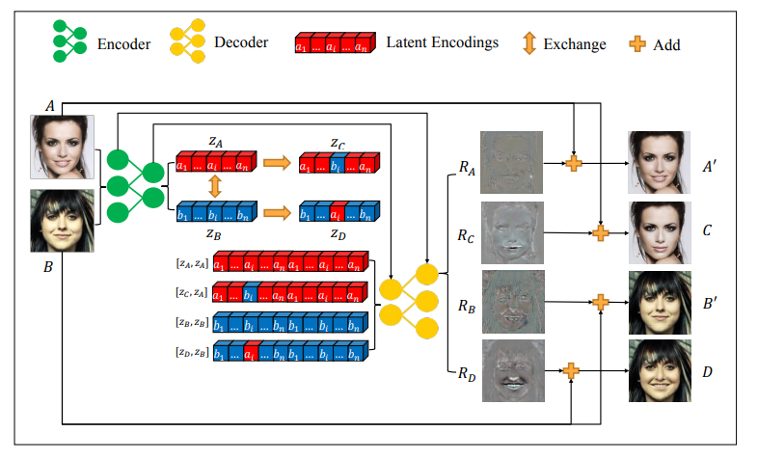

Slide 5
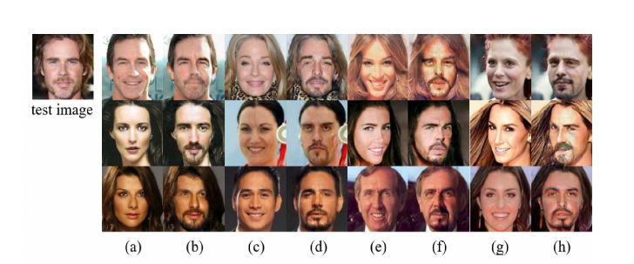
Combine with K-same

Slide 6
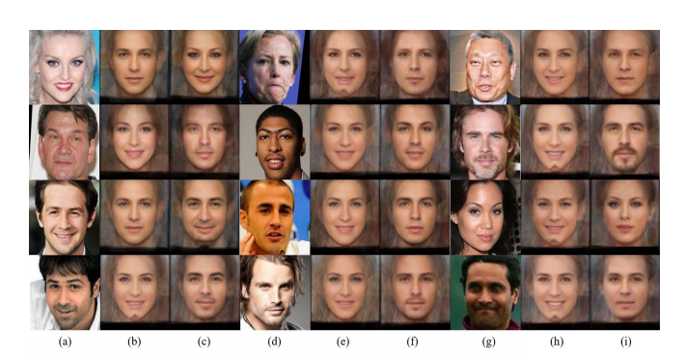
Combine with K-same

